Slide 1
Project 3: AI-Powered Ad Creatives
Vedant Sathye, Rishi Upadhyay, Abhishek Karnik

Slide 2
Introduction
In 2021, $600 Billion was spent on digital ads
Paying artists can be an expensive and long process
Finalized products can require weeks of iteration and tester/consumer feedback
AI can create art based on textual descriptions within minutes
An end to end pipeline that incorporates consumer feedback and model tuning could effectively create AI ads that are custom tailored towards consumers
Web app used to gather data on user feedback for tuning

Slide 3
Related Work
Two key areas we build on:
Synthetic Image Generation
AI-Powered Advertisements

Slide 4
Related Works - Synthetic Image Generation: GAN
Generative Adversarial Networks: One of the most popular
Setup two neural networks to compete
Generator takes random noise and outputs image from predefined distribution
Discriminator determines if image is real from distribution or fake created by generator
Both are trained to improve functionality
Not feasible to use as it creates images from noise
Cannot ask for specific image

Slide 5
Related Works - Synthetic Image Generation: VAE
Variational Auto-Encoders:
Two neural networks working together
Encoder takes images and outputs latent vector
Vector smaller than image but contains all necessary info
Encoder takes latent vector and attempts to recreate original image
Not feasible to use due to poorer performance as compared to GAN

Slide 6
Related Works - Synthetic Image Generation: Diffusion Based Models
Begin with random noise image and denoise image towards direction of prompt
After the removal of noise, a high quality image following the prompt is produced
DALL-E is a well known example using this method
Very suitable for our project
Follows prompt precisely
Produces high quality, photo-realistic results

Slide 7
Related Works - Synthetic Image Generation: Dreambooth
Built on top of Stable Diffusion
Generate varied images of a specified object
Only 3-5 images of object as input
Also takes several images of general class to avoid overfitting
i.e. Object = Toyota Camry, Class = Cars
Ideal for our project
Desire various images of the object
Have limited data for image generation iterations after user feedback

Slide 8
Related Works - AI Powered Advertisements
Recent increase in synthetic image generation tools have led to a greater opportunity for AI Powered Advertising
Omneky
Startup utilizing DALL-E to generate ad creatives
Limitation: Large amounts of human intervention required
Use of Human Artists for Image Generation
Others such as Rosebud.AI, Datagrid with own limitations
Rosebud: Only Face Generations
DataGrid: Uses GAN Which is an Older Technique

Slide 9
Methodology
User is asked for specific and generic classes of data (e.g. black rabbit, and rabbit)
Data is pulled from Google Images
Dreambooth is trained on images
Model generates new images based on sample prompts
Client uses “web” interface to click on ads and preference data is recorded
Model takes most popular results and retrains
Steps 4-6 occur until satisfactory images are generated

Slide 10
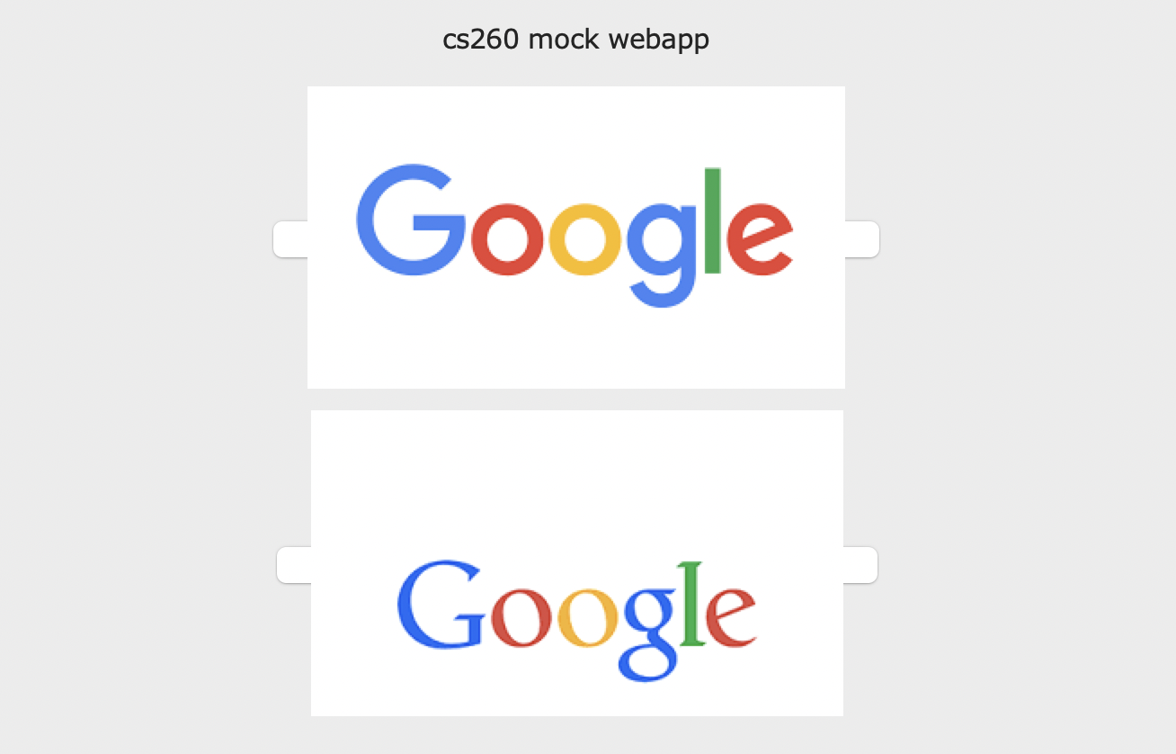

Slide 11
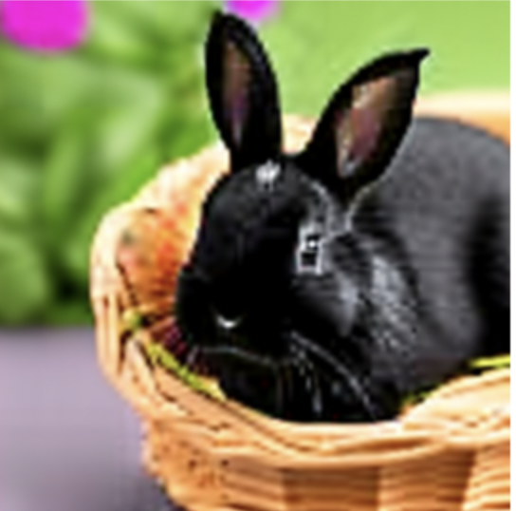
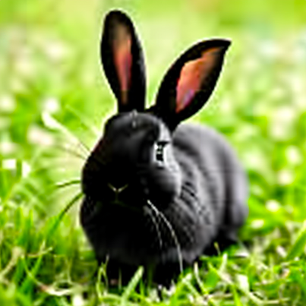
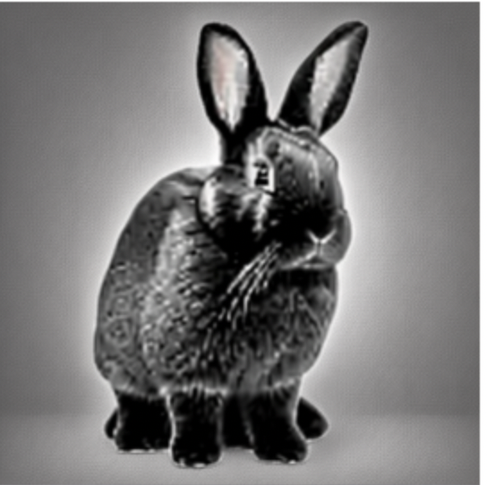
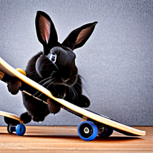
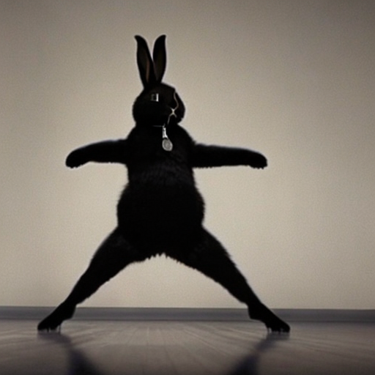
Results - Qualitative
“In basket”
Object:
Black Rabbit
“In grass”
“On skateboard”
“Doing a jump”

Slide 12
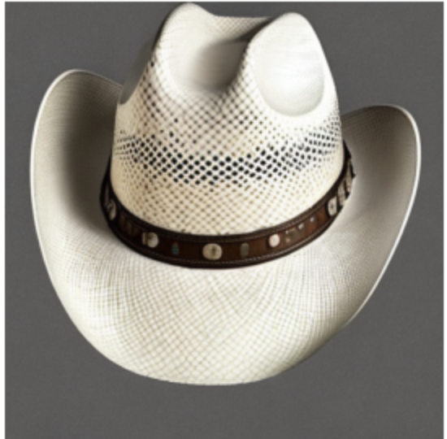
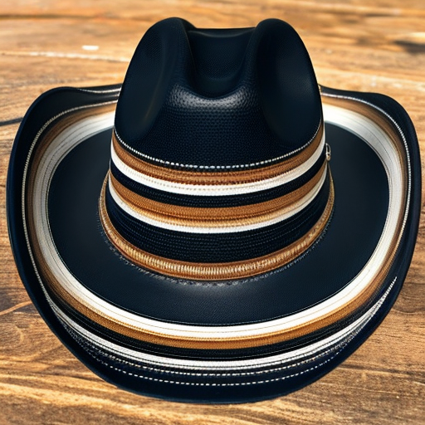
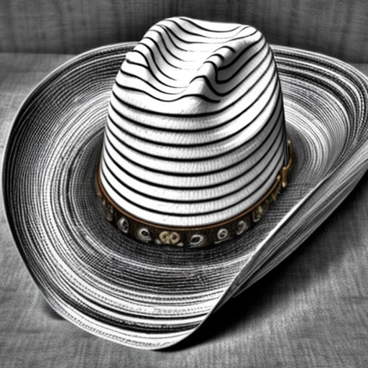
Results - Qualitative
Object:
Cowboy hat
Cowboy hat in stripes
Cowboy hat in stripes in monochrome

Slide 13
Results - Quantitative
Final loss of ~0.12 recorded when given 4 similar images of specific class and 20-30 images of generic class
Final loss of ~0.22 recorded when given specific class images with slight difference (i.e. one object is a different color etc.)
Increasing dataset size had unnoticeable effects on model loss
Optimal training happens around 800-1000 steps, validation loss begins to increase after that point
Generated images also suffer in terms of understandability
Extremely convoluted image descriptions also lead to lack of understandability and missing adjectives

Slide 14
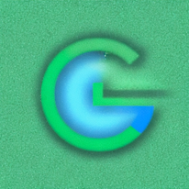
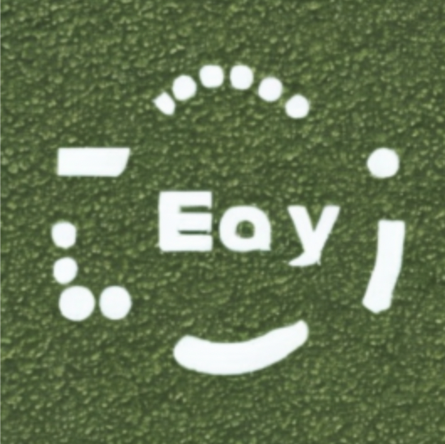
Results: Overfit images
“Google Logo in green in green in green”
“Google Logo in green”

Slide 15
Conclusion
AI can be an effective tool when generating images for advertisement purposes
As advertising industry grows along with AI image generation technology, this usage of AI in advertising will keep increasing
Competent iteration requires diversity in user base
Extremely time efficient (not including feedback latency) with a retraining cycle only taking ~30 minutes

